Slide 1
ADTs and Pointers

Slide 2
Abstract Data Types
Proper planning is essential to successful implementation of programs
Typical design methodologies focus on developing models of solutions before implementing them
These models emphasize structure and function of the algorithms used
Initially our attention is on what needs to be done, not how it is done
So we define program behavior in terms of operations to be performed on data

Slide 3
Abstract Data Types (continued)
The details will emerge as we refine the definitions of the operations
Only then will implementation of those operations be carried out
As part of this implementation, we must choose appropriate data structures
A data structure is a technique of storing and organizing data so it can be used efficiently
In our program models, data structures are described by abstract data types (ADTs)

Slide 4
Abstract Data Types (continued)
ADTs are defined indirectly, in terms of operations to be performed rather than in terms of its inner structure
ADTs can then be implemented through class definitions in an object-oriented language
For example, consider a stack ADT:

Slide 5
Abstract Data Types (continued)
A stack is a last-in first-out (LIFO) linear structure where items can only be added and removed from one end
Operations on this stack ADT might include:
PUSH – add an item to the stack
POP – remove the item at the top of the stack
TOP – return the value of the item at the top of the stack
EMPTY – determine if the stack is empty
CREATE – create a new empty stack
Notice these simply describe the things we can do, not how they are done
These details will be reserved for implementation

Slide 6
Encapsulation
Fundamental to object-oriented programming (OOP) is the notion of an object
An object is a data structure, combined with the operations pertinent to that structure
Most object-oriented languages (OOLs) define objects through the use of a class
A class is a template which implements the ADT defining the objects the class creates
Within a class, the data elements are called data members, and the operations methods, function members, or member functions

Slide 7
Encapsulation (continued)
The combination of data members and methods in a class is referred to as data encapsulation
An object, then, can also be defined as the instantiation of a class, creating an entity that can be used in a program
This concept is a very powerful and useful tool in modern programming
In non-OOLs, the program code itself is responsible for determining the associations between data and functions
In contrast, data encapsulation binds the data structure and its operations together in the class
The program can then focus on the manipulation of these objects through their associated methods

Slide 8
Encapsulation (continued)
This approach has several advantages:
The strong link between data and operations better mimics real-world behavior, on which program models are based
Errors in implementation are confined to the methods of a particular class in which they occur, making them easier to detect and correct
Details of the implementation of the object can be hidden from other objects to prevent side effects from occurring
This last point illustrates the principle of information-hiding
Our use of an object is based on what it does for us, not how it goes about doing it
So an object can be looked at as a black box, with specific user-available methods and a well-defined behavior

Slide 9
Encapsulation (continued)
These user-accessible components comprise an object’s public interface; the remaining methods and data are private

Slide 10
Encapsulation (continued)
Information-hiding also means that every object we use is independent of all other objects, unless we define methods for communicating between objects
Even then, the degree to which the objects interact is precisely defined by the communication methods, known as message passing
This is analogous to function calls in classical programming
An object responds to a message by executing the appropriate method to return information

Slide 11
Encapsulation (continued)
The class as a creator of objects allows great freedom to define objects of the same class with different properties
Default parameters in constructors, combined with well-crafted methods, allow objects to exhibit considerable flexibility
Generic classes offer further flexibility by allowing type parameters to generalize data members and methods
This allows objects to be modified or replaced by other objects that are more efficient or better suited to particular circumstances while the user interface and message passing remains the same

Slide 12
Pointers
A variable defined in a program has two important attributes
Its content or value (what it stores)
Its location or address (where it is)
Normally, we access a variable’s contents by specifying the variable’s name in an operation
However, it is possible to store a variable’s address in another variable
This new variable is called a pointer; it allows us access to the original variable’s value through its address
A pointer is a variable whose value is the address of another variable in memory

Slide 13
Pointers (continued)
Pointers are defined much the same as other variables
They have a type; in this case the type of variable they point to
They have a user-defined name
The name is preceded by an asterisk (“*”) to indicate the variable is a pointer
Given the declarations
int i=15,j,*p,*q;
i and j are integer variables, while p and q are pointers to integer variables
If the variable i is at memory location 1080, and each variable occupies two bytes, figure 1-1a illustrates this layout

Slide 14
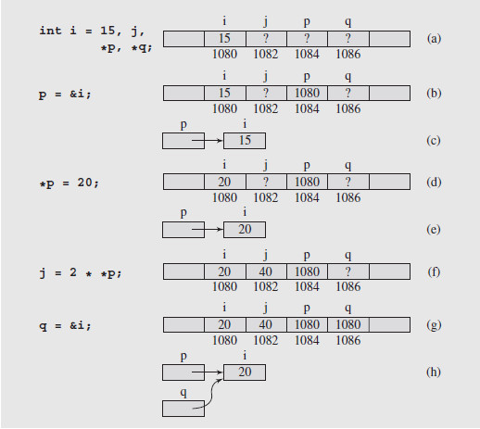
Pointers (continued)
Fig. 1-1 Changes of values after assignments are made using pointer variables; note that (b) and (c) show the same situation, and so do (d) and (e), (g) and (h), (i) and (j), (k) and (l), and (m) and (n)

Slide 15
Pointers (continued)
To assign a variable’s address to a pointer, the address-of operator (&) is placed before the variable
For pointer p to point to variable i, we write
p = &i;
This pointer is then said to point to that variable
This is shown in figure 1-1(b); a common way to draw this relationship is shown in figure 1-1(c)
To access the value a pointer points to, we have to dereference the pointer, using the dereference operator, an asterisk (“*”)
So *p refers to the location stored in p, the address of i

Slide 16
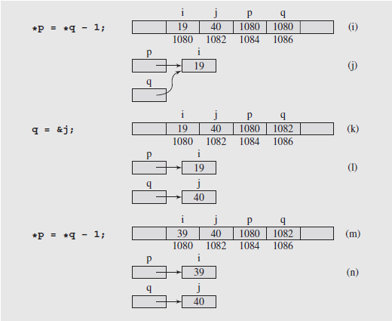
Pointers (continued)
This is shown in figure 1.1(d); figures (e) to (n) show other examples

Slide 17
Pointers (continued)
In addition to variables, pointers can be used to access dynamically created locations
These are created during runtime using the memory manager
Two functions are used to handle dynamic memory
To allocate memory, new is used; it returns the address of the allocated memory, which can be assigned to a pointer
p = new int;
To release the memory pointed at, delete is used
delete p;
Care must be exercised when using this type of memory operation

Slide 18
Pointers (continued)
One problem can arise when an object is deleted without modifying the value of the pointer
The pointer still points to the memory location of the deallocated memory
This creates the dangling reference problem
Attempting to dereference the pointer will cause an error
To avoid this, after deleting the object, the pointer should be set to a known address or NULL, which is equivalent to 0
p = NULL; or p = 0;

Slide 19
Pointers (continued)
The second type of problem that can occur with dynamic memory usage is the memory leak
This occurs when the same pointer is used in consecutive allocations, such as:
p = new int;
p = new int;
Since the second allocation occurs without deleting the first, the memory from the first allocation becomes inaccessible
Depending on code structure, this leak can accumulate until no memory is available for further allocation
To avoid this, memory needs to be deallocated when no longer in use

Slide 20
Pointers (continued)
Pointers and Arrays
Pointers’ ability to access memory locations through their addresses provides us with numerous processing advantages
Typically, arrays in C++ are declared before they can be used, known as static declaration
This means the size of the array must be determined before it is used
This is wasteful if the array is too large, or a limitation if the array is too small
However, the name of an array is nothing more than a label for the beginning of the array in memory, so it is a pointer

Slide 21
Pointers (continued)
Pointers and Arrays (continued)
For example, an array declared:
int temp[7];
would appear in memory as:
In array notation, we access the elements by subscripting: temp[0], temp[1], … etc.
But we can also dereference the pointer to achieve the same results: *temp is equivalent to temp[0]
And we can access additional elements through pointer arithmetic

Slide 22
Pointers (continued)
Pointers and Arrays (continued)
In pointer arithmetic, we can add an offset to the base address of the array: temp + 1, temp + 2, … etc. and dereference the result
So *(temp + 1) is the same as temp[1], *(temp + 2) is equivalent to temp[2], etc.
And as long as we don’t try to change the value of temp, we can use this alternate approach to access the array’s elements
Now remember that a pointer can be used in the allocation of memory without a name, through the use of new
This means that we can also declare an array dynamically, via
int *p; p = new int[n];
As long as the value of n is known when the declaration is executed, the array can be of arbitrary size

Slide 23
Pointers (continued)
Pointers and Arrays (continued)
Now, a reference to an element of the array is constructed by adding the element’s location to p and dereferencing, as before
And we can assign other pointers to the array by simply declaring them and copying the value of p into the new pointer, if needed
This also allows us to conveniently dispose of an array when we no longer need it, using:
delete[] p;
The brackets indicate that an array is to be deleted; p is the pointer to that array

Slide 24
Pointers (continued)
Pointers and Copy Constructors
A potential problem can arise when copying data from one object to another if one of the data members is a pointer
The default behavior is to copy the items member by member
Because the value of a pointer is an address, this address is copied to the new object
Consequently the new object’s pointer points to the same data as the old object’s pointer, instead of being distinct
To correct this, the user must create a copy constructor which will copy not only the pointer, but the object the pointer points to
This conflict is illustrated in figure 1-2(a) and (b); the resolution is shown in figure 1-2(c) and (d)

Slide 25
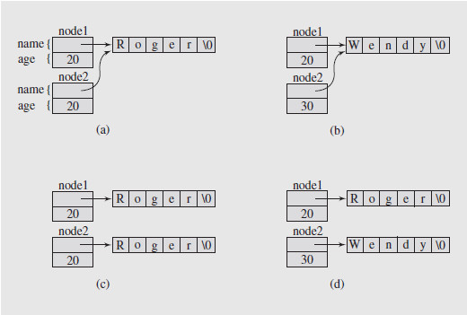
Pointers (continued)
Pointers and Copy Constructors (continued)
Fig. 1-2 Illustrating the necessity of using a copy constructor for objects with pointer members

Slide 26
Pointers (continued)
Pointers and Destructors
When a local object goes out of scope, the memory associated with it is released
Unfortunately, if one of the object members is a pointer, the pointer’s memory is released, leaving the object pointed at inaccessible
To avoid this memory leak, objects that contain pointers need to have destructors written for them
A destructor is a code construct that is automatically called when its associated object is deleted
It can specify special processing to occur, such as the deletion of pointer-linked memory objects

Slide 27
Pointers (continued)
Pointers and Reference Variables
There is a close correspondence between pointers and reference variables
This is because reference variables are implemented as constant pointers
Given the declarations:
int n = 5,*p = &n,&r = n;
a change to the value of n via any of the three will be reflected in the other two
Thus n = 7 or *p = 7, or r = 7 accomplishes the same result; the value of n is now 7
So we can dereference a pointer, or use a reference directly to access the original object’s value

Slide 28
Pointers (continued)
Pointers and Reference Variables (continued)
We do have to exercise care in declaring pointers, though, because
int *const
declares a constant pointer to an integer, while
const int *
declares a pointer to a constant integer
The latter can cause errors if we attempt to assign a value through a dereferenced pointer
Reference variables are valuable in working with functions, as they allow us to modify the values of arguments
They can also be returned from a function
While pointers can be used instead, they have to be dereferenced

Slide 29
Pointers (continued)
Pointers and Reference Variables (continued)
We do have to be careful when we use references in classes
It is possible to compromise information hiding if a public method returns a reference to a private data member
This reference, as an address, allows bypassing of the protection mechanisms provided in the class definition
Data corruption can result

Slide 30
Pointers (continued)
Pointers and Functions
The same characteristics of variables – value (or contents) and location (or address) – can also be applied to functions
A function’s value is the result it returns, and its address is the memory location of the function’s body
So we can use a pointer to a function to access it
Given a function temp, its name, temp, is a pointer to the function and *temp is the function itself
Following the dereferenced pointer with an argument list will call the function and pass the argument values
Using this we can implement functionals, functions that take functions as arguments

